Slide 1
A remotely monitored VLBI-network of autonomous telescope agents
(e-RemoteCtrl for VLBI)
Alexander Neidhardt (FESG, TUM)
neidhardt@fs.wettzell.de
Katharina Kirschbauer (THD), Matthias Schönberger (BKG), Jim Lovell (UTAS),
Ed Himwich (NASA/GSFC/NVI), Jamie McCallum (UTAS), Christian Plötz (BKG),
Jonathan Quick (HartRAO)

Slide 2
The idea behind
REMOTE CONTROL
is not …

Slide 3
The idea behind
REMOTE CONTROL
is not …
Reference:
https://www.google.it/search?q=pinky+and+the+brain&espv=2&biw=1523&bih=895&tbm=isch&source=lnms&sa=X&ved=0CAYQ_AUoAWoVChMIucPf-uSuyAIVh-saCh2sNQkY#tbm=isch&tbs=rimg%3ACXS9UOMjN6chIjjatA5Eqprg78c6NKsJgMnXbHOTXq8QFMDdyU896vE94c-86oz4S5f3xoY4YdwaPurls_1SLuD03fioSCdq0DkSqmuDvEUYZrgBFIs2zKhIJxzo0qwmAydcRF99tQulkd0kqEglsc5NerxAUwBG06peKodSSICoSCd3JTz3q8T3hERWL-HjrvUFqKhIJz7zqjPhLl_1cRBdAi2-wlhnUqEgnGhjhh3Bo-6hEeeYkCeTHGvSoSCeWz9Iu4PTd-EWTwuPMq3sxG&q=pinky%20and%20the%20brain&imgdii=dL1Q4yM3pyGhSM%3A%3BdL1Q4yM3pyGhSM%3A%3B2rQORKqa4O-fhM%3A&imgrc=dL1Q4yM3pyGhSM%3A

Slide 4
Why is a new operation technique important?

Slide 5
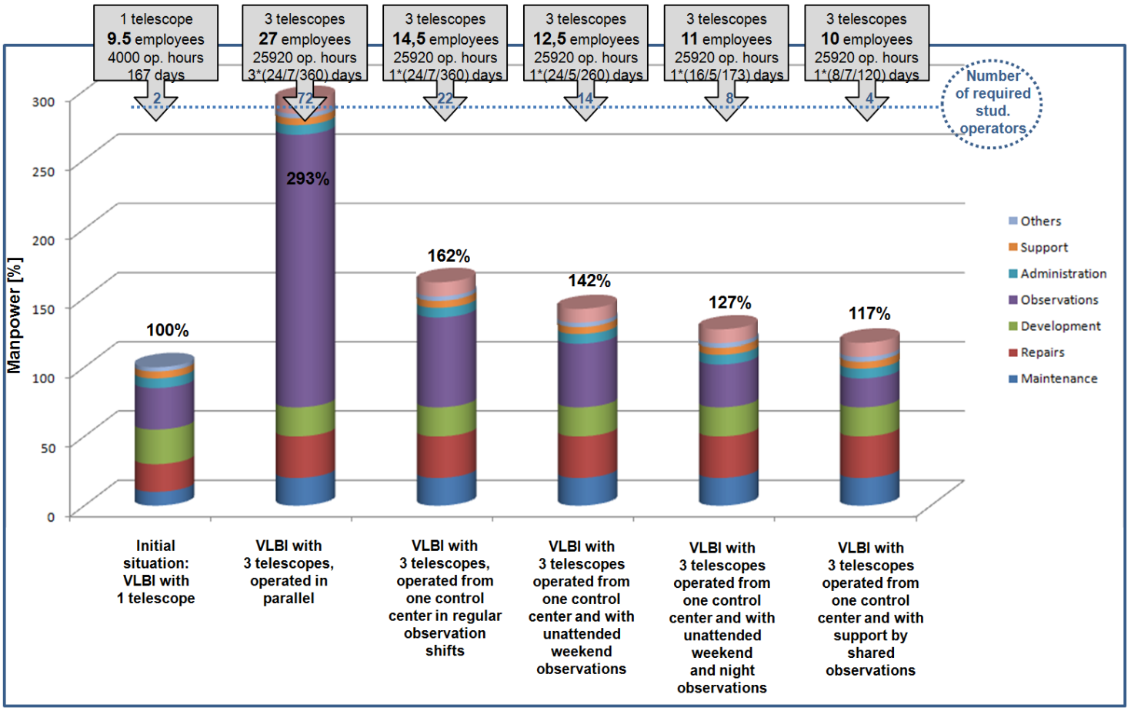
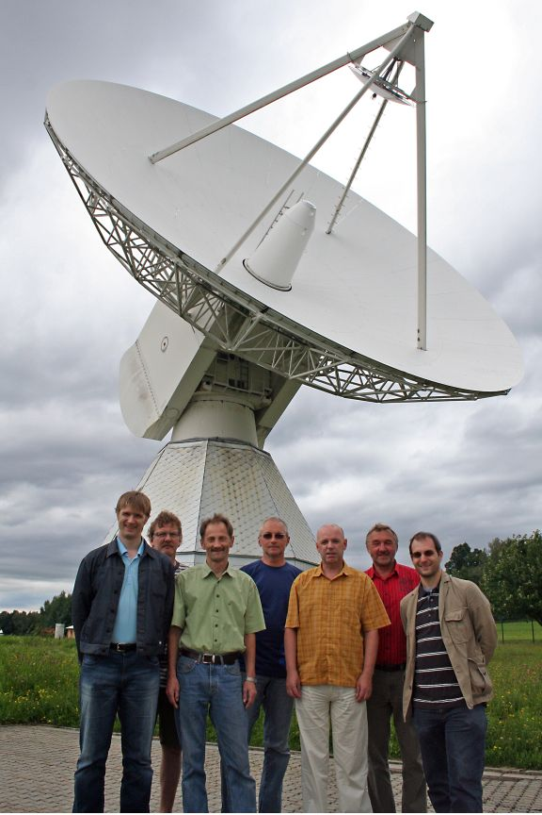
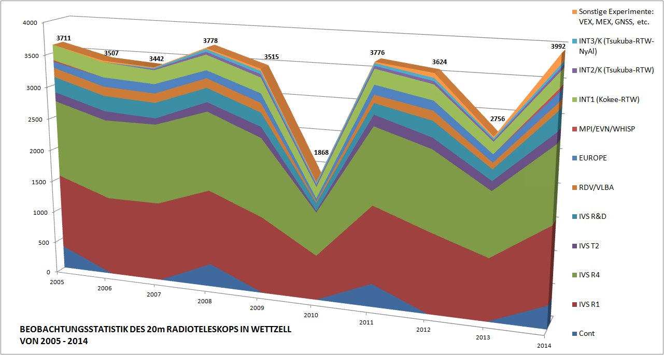
Why is a new operation technique important?
8 staff memebers in the
VLBI-working group
Ch. Plötz, E. Bauernfeind,
G. Kronschnabl, R. Schatz,
W. Schwarz, R. Zeitlhöfler,
A. Neidhardt
(not in the image: E. Bielmeier).
+ 1 project position
+ 2 student operators
ca. 4000 operating hours per year
ca. 150 24h sessions
ca. 400 1h sessions

Slide 6
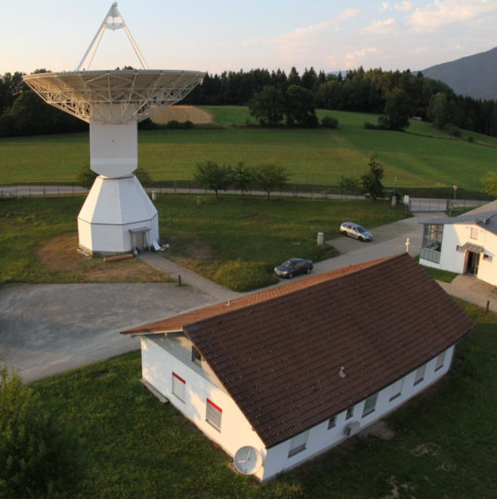
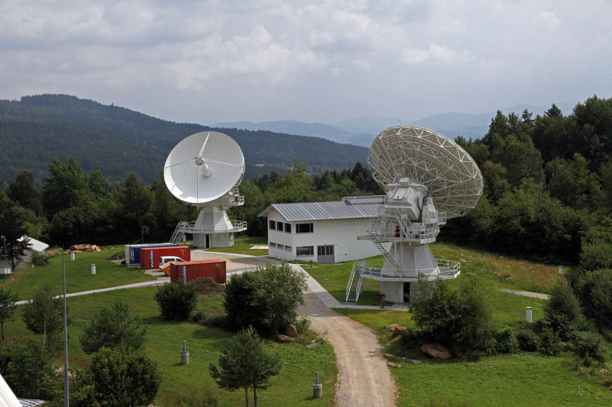
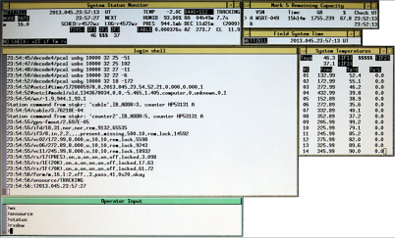
Why is a new operation technique important?

Slide 7
Why is a new operation technique important?

Slide 8
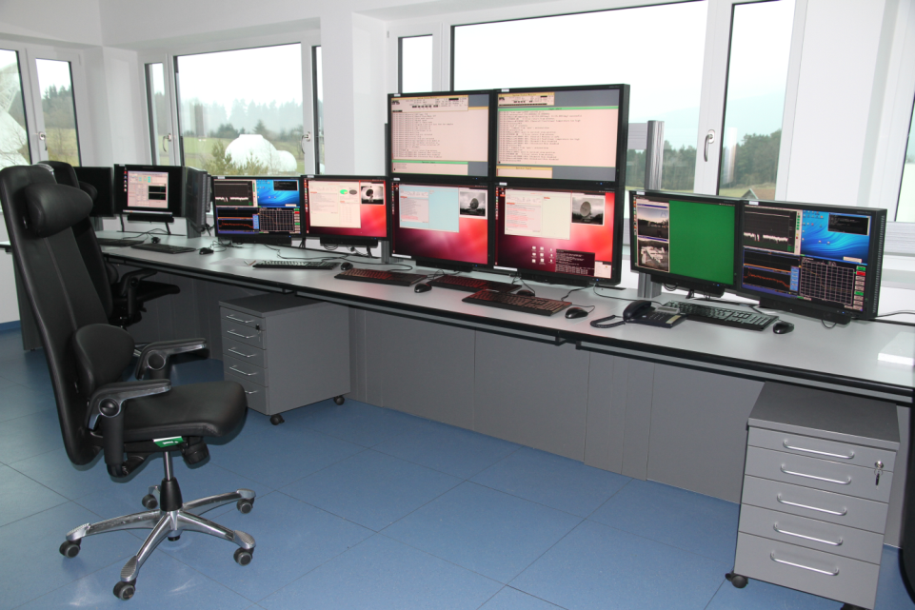
Why is a new operation technique important?
TTW Control Room
Requirements:
Remote Control &
Optimized Monitoring

Slide 9
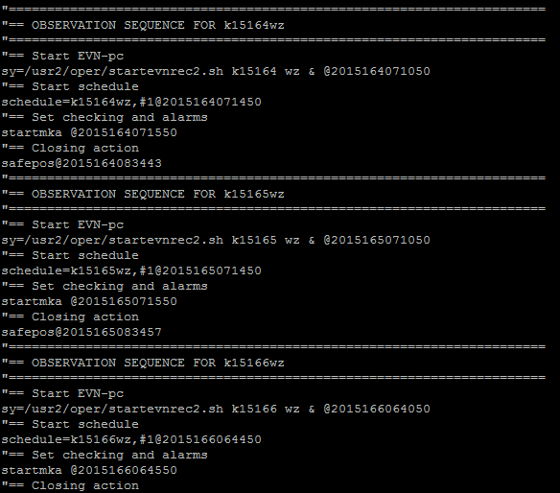
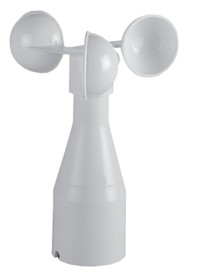
Why is a new operation technique important?
Local Scheduler
„MakeWeekend“
TTW Control Room
e.g.
Wind Stow
Requirements:
Automation &
Safety Management

Slide 10
Why is a new operation technique important?

Slide 11
Why is a new operation technique important?
Requirements:
Cooperating
Control
Centers

Slide 12
Why is a new operation technique important?
BUT:
New jobs, like data logistics, are not yet included to this statistics.

Slide 13
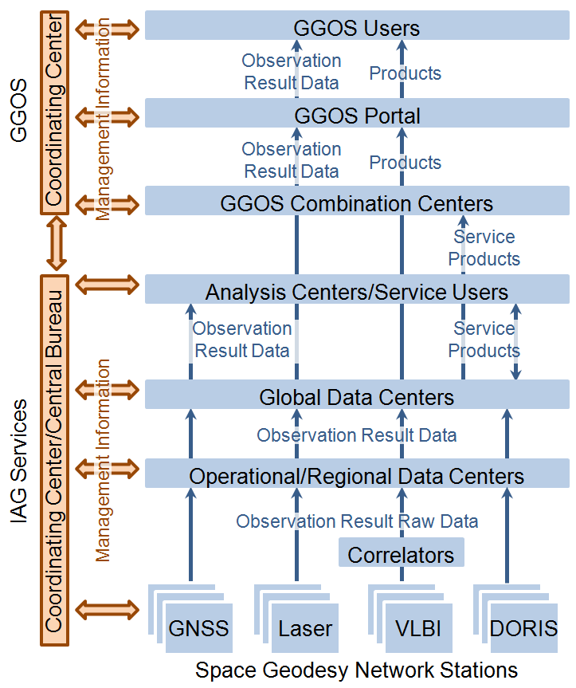
Why is a new operation technique important?
Increased or new requirements and orders by science
One telescope leaves a
network (wind, damages)
=> Optimize the network
Prioritized events: occultaions,
supernovaes, space crafts, …
Improved or new services
Short reaction times
Common, dynamic observations
…
[plag2009] l.c. page 261

Slide 14
Why is a new operation technique important?
What is already possible?

Slide 15
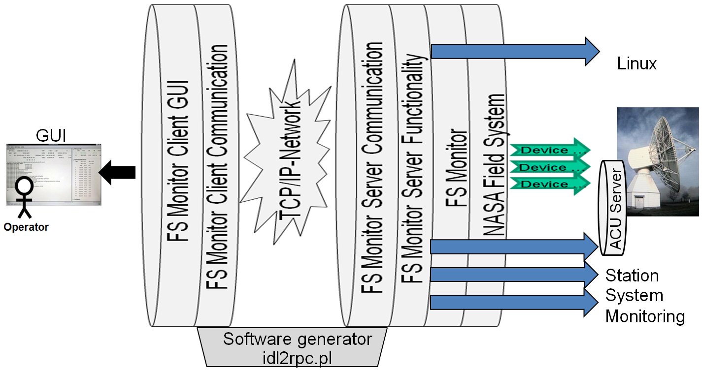
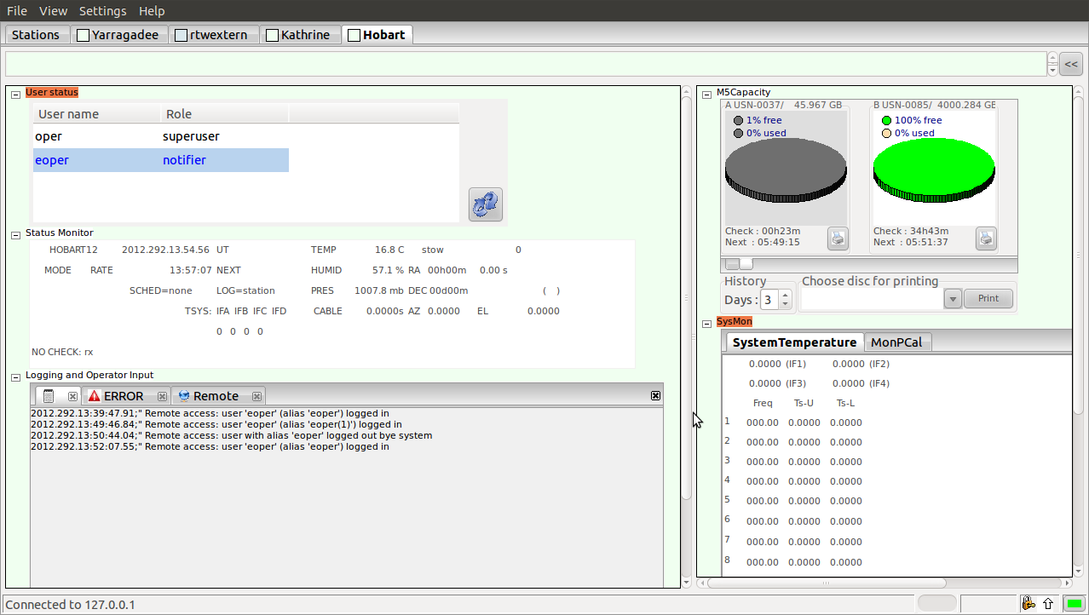
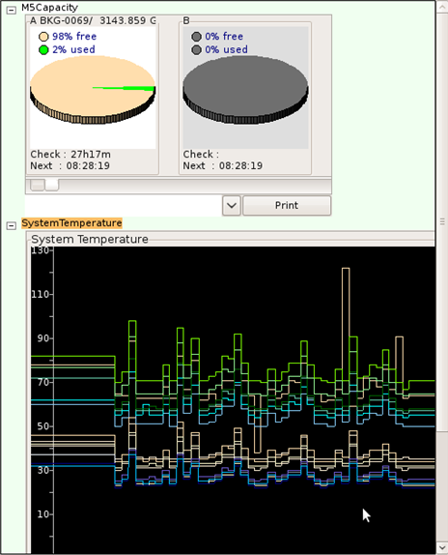
What is already possible?
Remote Control Middleware
e-RemoteCtrl

Slide 16
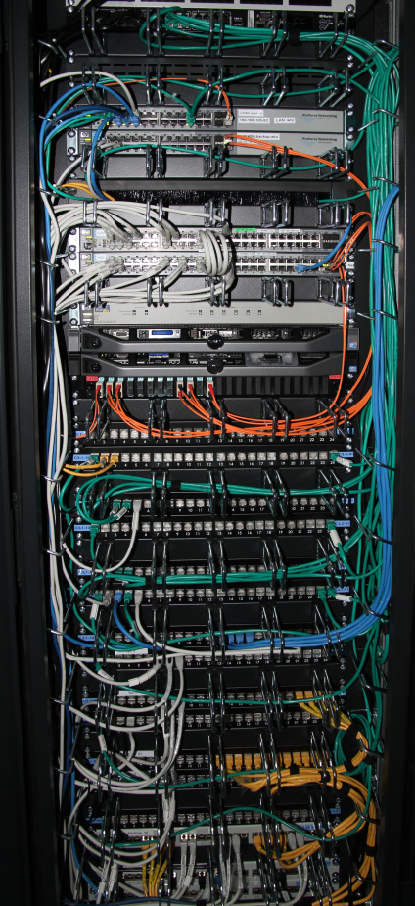
What is already possible?
Network
Remote Control Middleware
e-RemoteCtrl

Slide 17
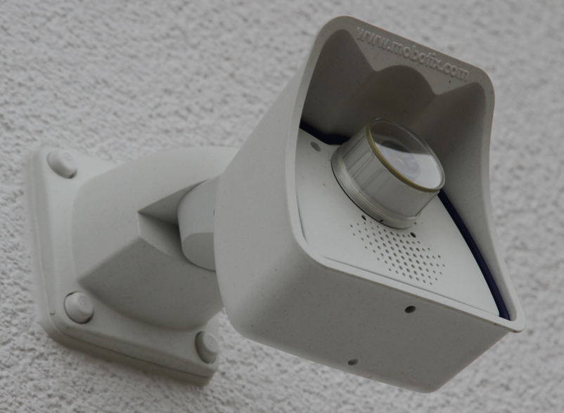
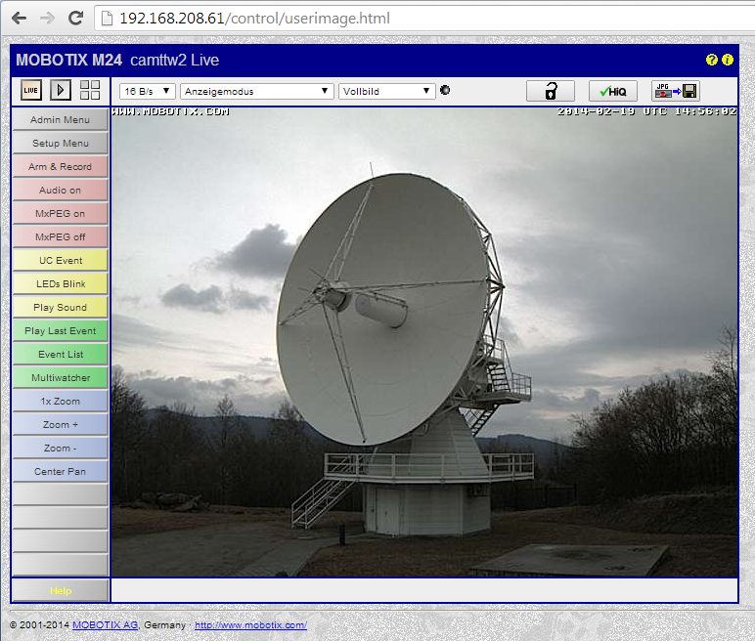
What is already possible?
Network
Web-
Cams
Remote Control Middleware
e-RemoteCtrl

Slide 18
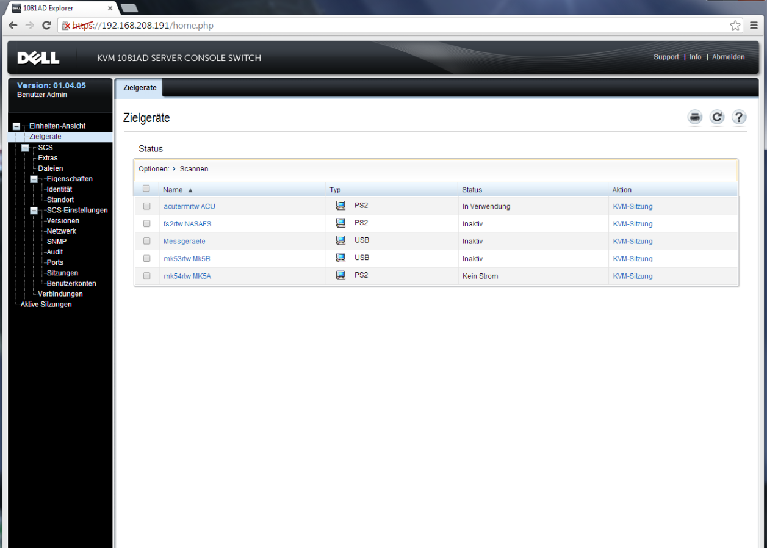
What is already possible?
Network
Web-
Cams
KVM
Remote Control Middleware
e-RemoteCtrl

Slide 19
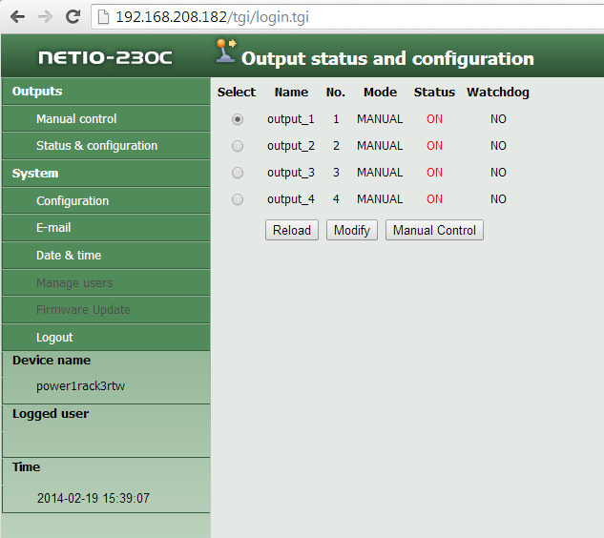
What is already possible?
Network
Web-
Cams
KVM
Power
Switches
Remote Control Middleware
e-RemoteCtrl

Slide 20
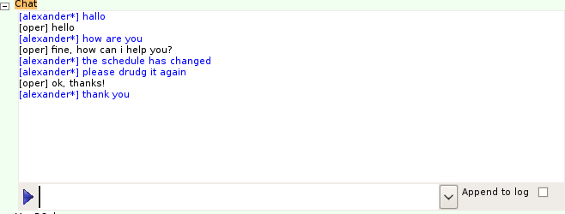
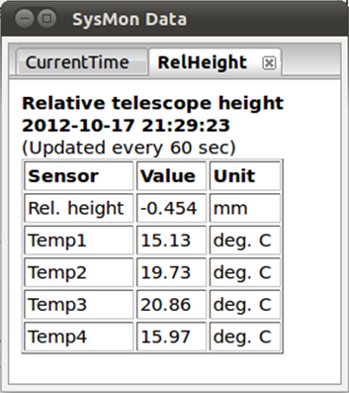
What is already possible?
User
status
Mark 5 capacity
Status
monitor
Logging &
Command
input
Chat
Connection status
Remote Control Middleware e-RemoteCtrl

Slide 21
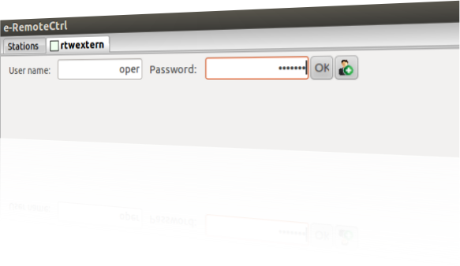
What is already possible?
User role management with
authentication and authorization
and encrypted tunneling
Static
Roles
Dynamic
Roles
Observer
Notifier
Notifier
Currently
not
used
Scheduler
Number of users
Role change
Agent
User rights
Operator
Operator
Supervisor
Operator
Superuser
Read
Chat
Schedule
(drudg)
Adapt
(attenuation)
Control
System
change

Slide 22
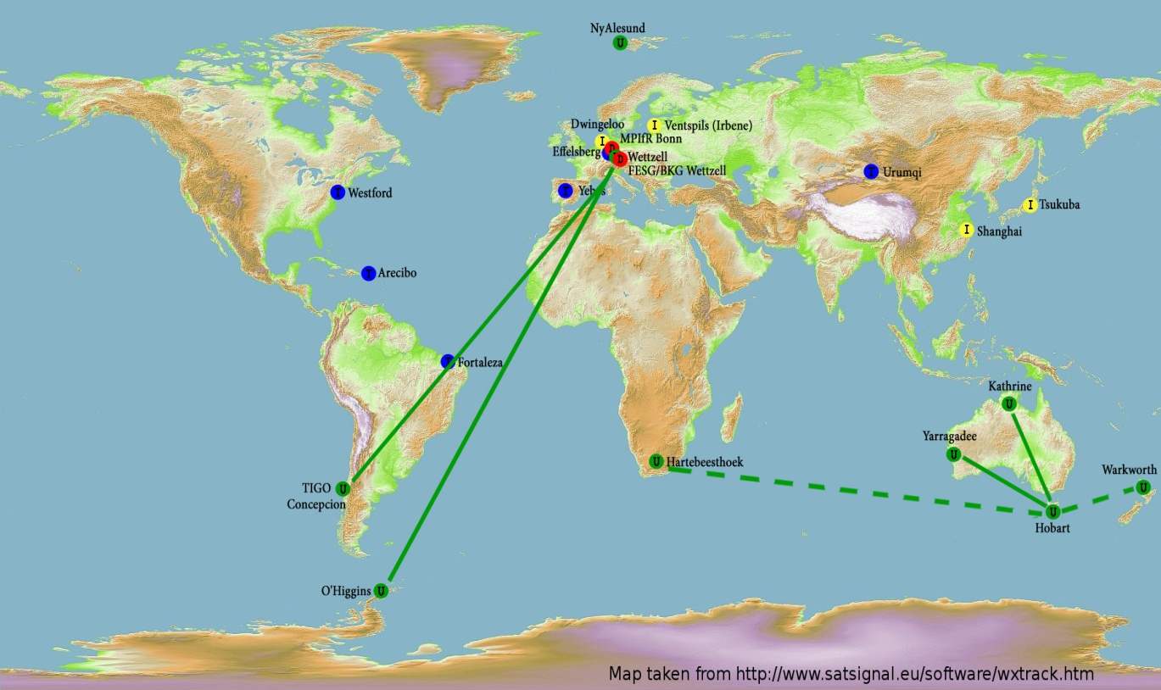
What is already possible?
Current e-RemoteCtrl Network
Regularly:
AuScope-(Warkworth)-Hartebesthoek-Network,
(TIGO)-O’Higgins-Wettzell-Network

Slide 23
Why is a new operation technique important?
What is already possible?
What is reachable in the near future?

Slide 24
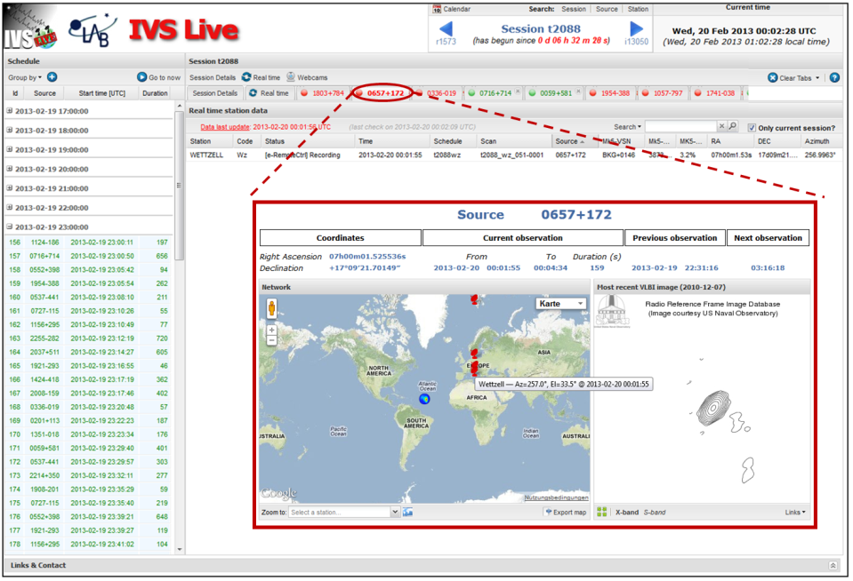
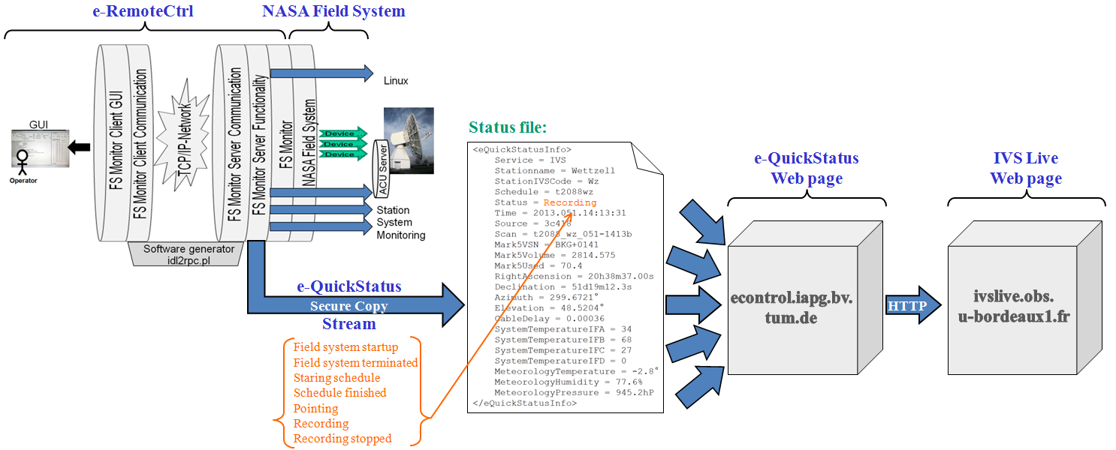
What is reachable in the near future?
Data sender, comparable to the
feedback to the IVS e-QuickStatus
Fix the sending problem
Extend e-RemoteCtrl
Field system startup
Field system terminated
Starting schedule
Schedule finished
Pointing
Recording
Halt
Continue
Status data

Slide 25
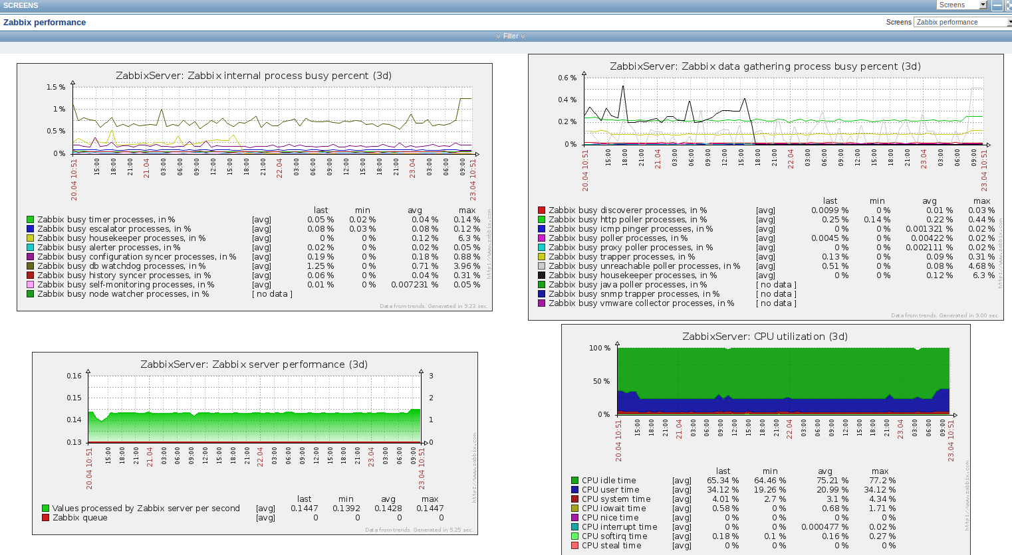
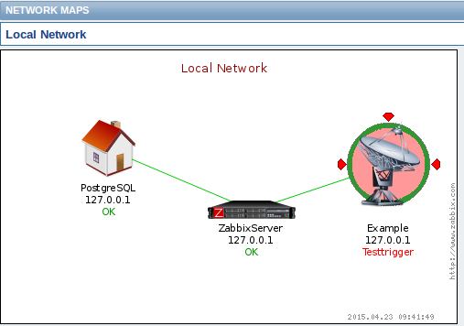
What is reachable in the near future?
Auxiliary Data Center with Zabbix Web frontend
Graphs
Maps

Slide 26
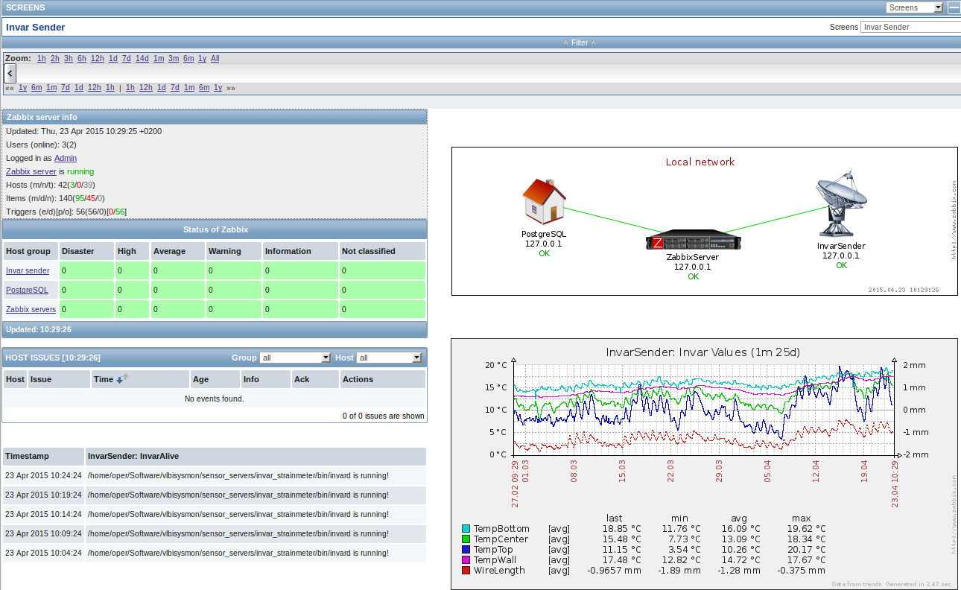
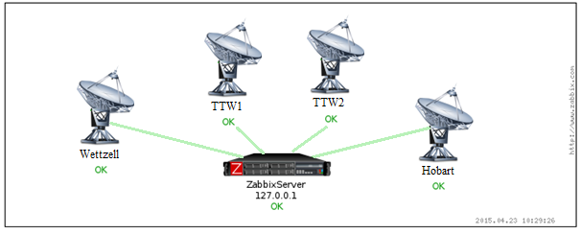
What is reachable in the near future?
Auxiliary Data Center with Zabbix Web frontend (cont.)

Slide 27
Why is a new operation technique important?
What is already possible?
What is reachable in the near future?
What is conceivable in the further future?

Slide 28
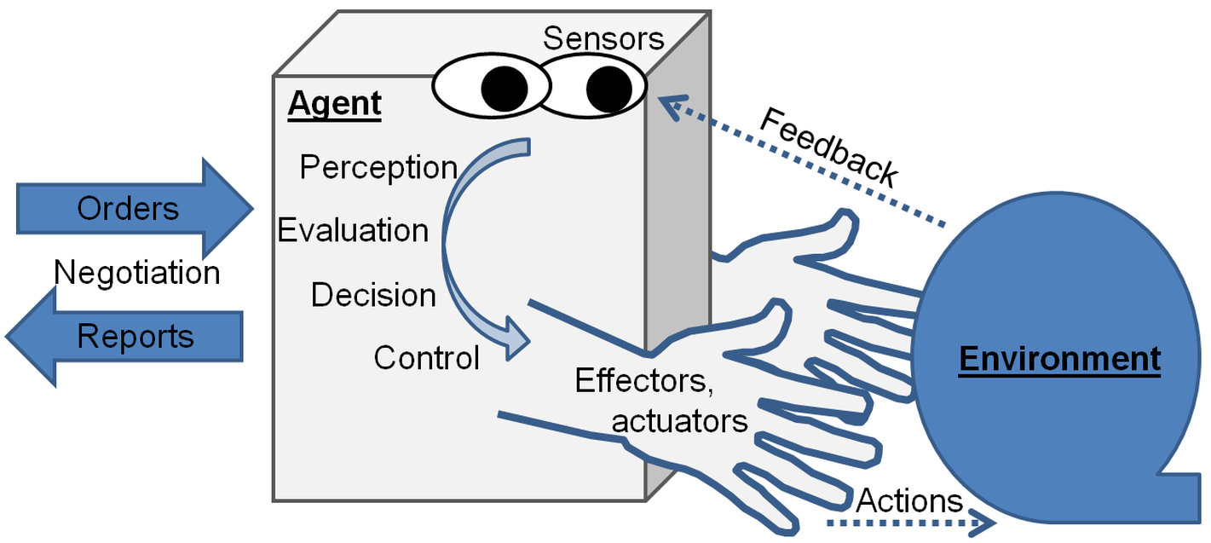
What is conceivable in the further future?
Autonomous agents handle requests

Slide 29
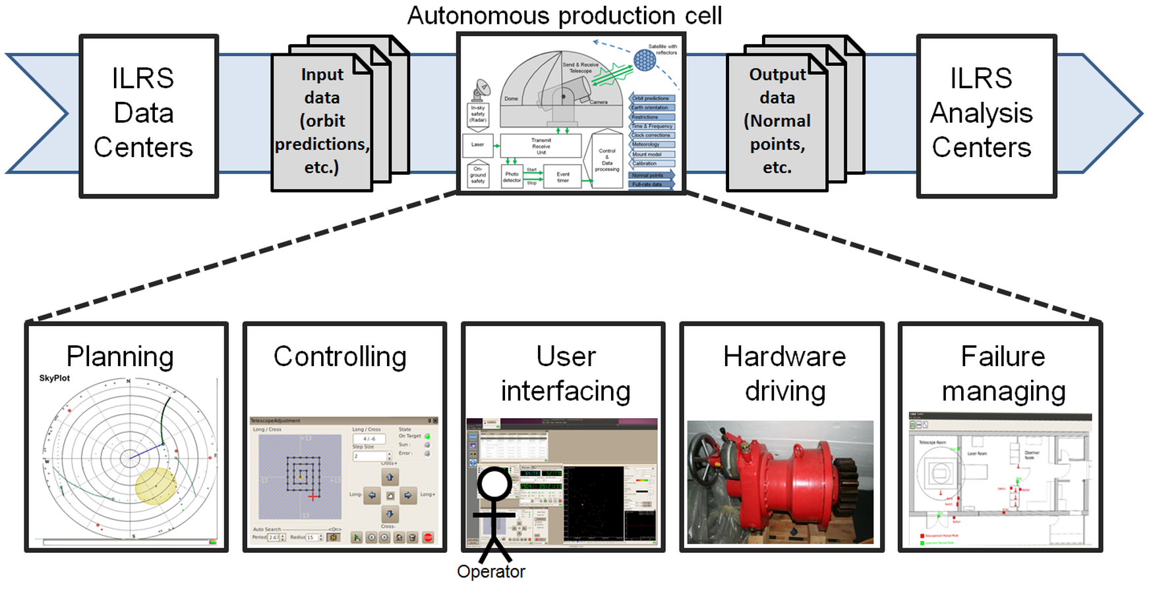
What is conceivable in the further future?
Autonomous production cells take the orders from the agents

Slide 30
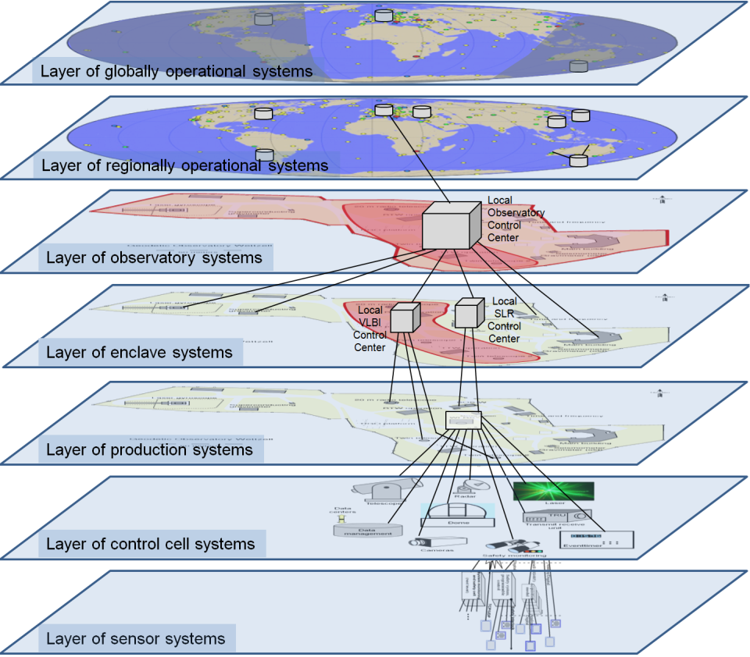
What is conceivable in the further future?
Autonomous production cells take the orders from the agents

Slide 31
Thank you for your support and attention!!!
The software will be available on the Web page
http://www.econtrol-software.de
“Future needs the courage
to accept changes!”

Slide 32
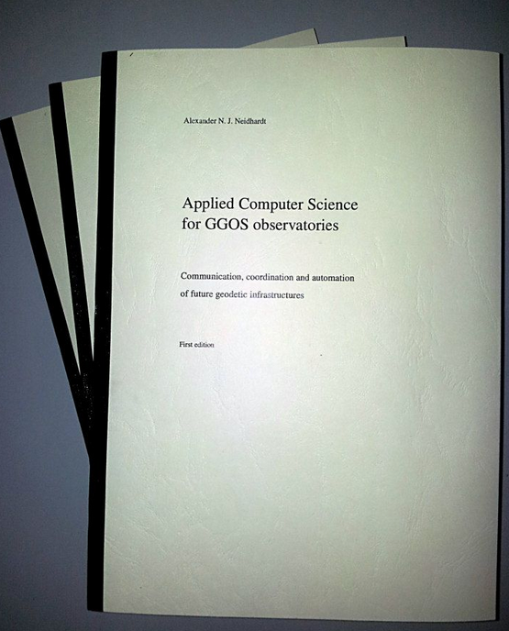
Thank you for your support and attention!!!
The software will be available on the Web page
http://www.econtrol-software.de
“Future needs the courage
to accept changes!”
Publishing Aggreement with
Int.
as
Printed version,
Print-on-demand
&
eBook

